Slide 1
On Funnel Wall Variability
By Limeng Jiang

Slide 2
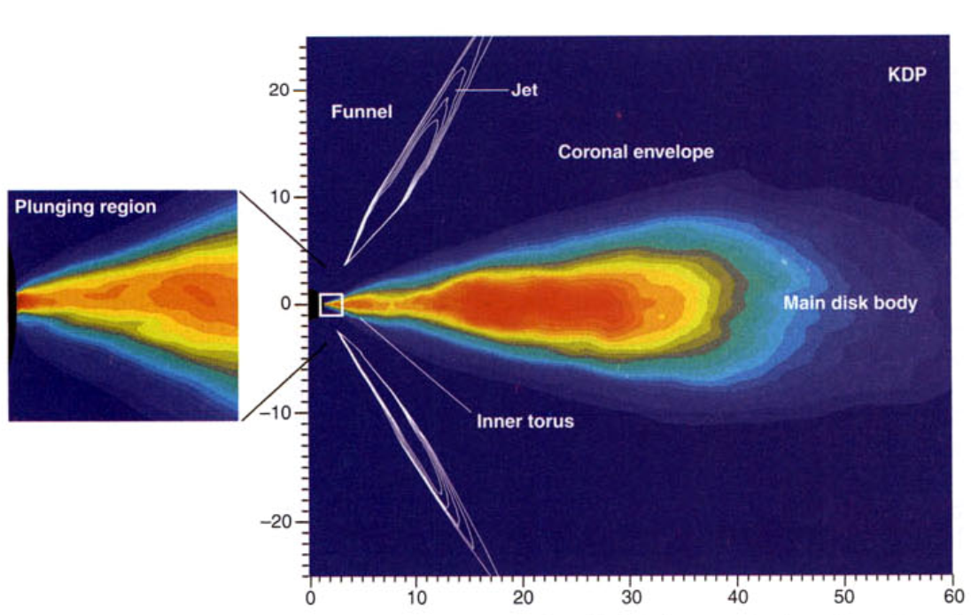
Basics
Accretion flows (disks) can be thin or thick, depending on the radiative efficiency
Jets may be formed by accretion flow’s ejections and the spin of the black hole
Assumption made: the dynamics of the accreting plasma can be recovered by treating the flow as a single, thermal fluid; they therefore track only the internal energy (or temperature) of the bulk plasma.

Slide 3
Goals/Questions to be Addressed
Does the funnel (jet) contribute to variability (in Te)?
If YES…
How variable are the different quantities in the funnel?
What are the physical mechanisms that causes these variabilities?
Can we model these mechanisms and make prediction about variabilities based on other parameters like spins and MAD vs SANE?
If NO…
Why?
In what regimes is this valid?
Can we predict extra variability (caused by the funnel) in different regimes?

Slide 4
To answer those questions…
Get some variance plots first to get some idea on the variabilities
For the mechanisms which cause the variability, from paper Angular Momentum Transport in Thin Magnetically Arrested Disks, the candidates are gas and magnetization.
To model those mechanisms and link them to the variability, derive a relation between var(Te) and the candidates above, which I choose ρ, Pg, and B²

Slide 5
γ=4/3
→ Te

Slide 6
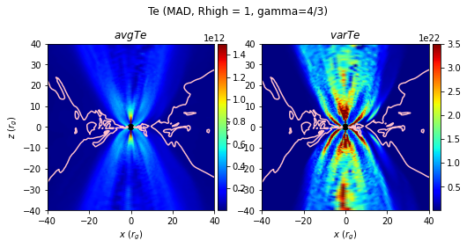
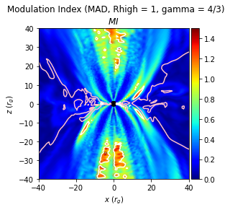
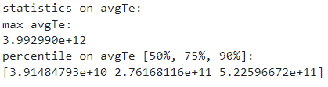
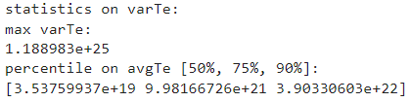
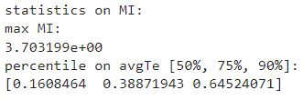
MAD, Rhigh=1
Pink contour is β=1 surface (i.e. where Pgas=Pmag)
Notes:
Visual effects; pay attention to the scale values

Slide 7
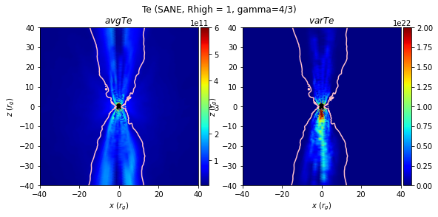
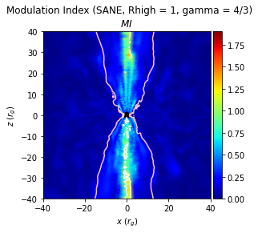
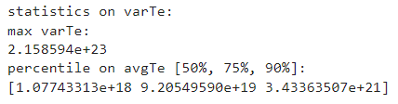
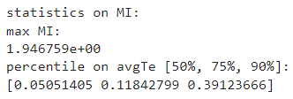
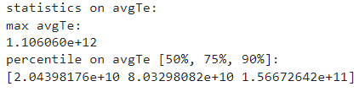
SANE, Rhigh=1

Slide 8
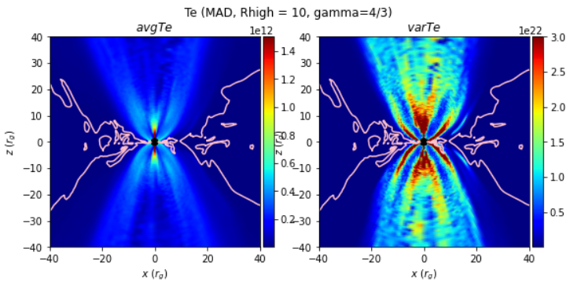
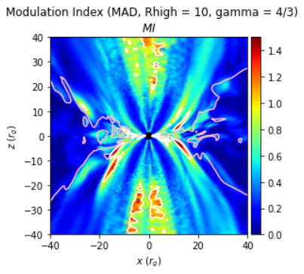
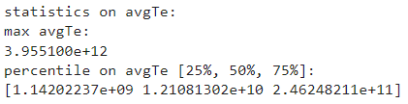
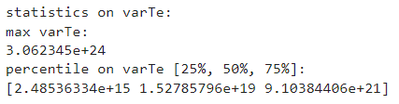
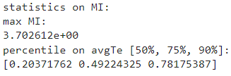
MAD, Rhigh=10

Slide 9
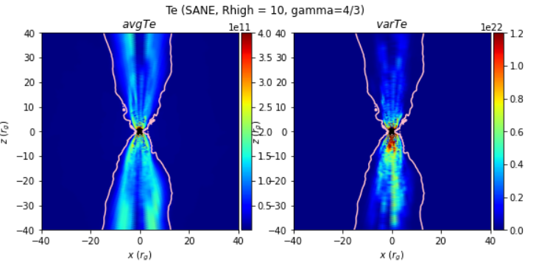
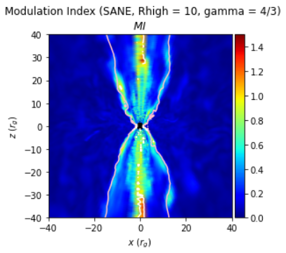
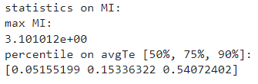
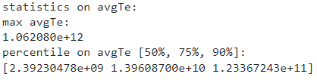
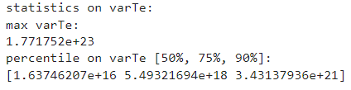
SANE, Rhigh=10

Slide 10
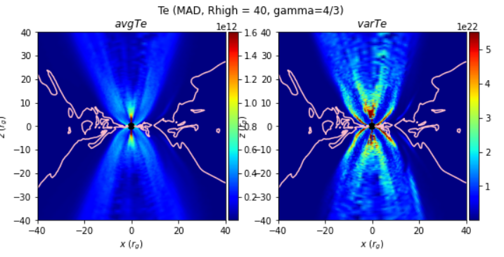
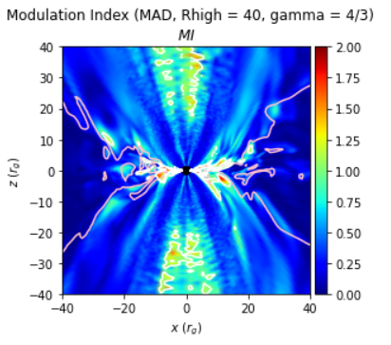
MAD, Rhigh=40

Slide 11
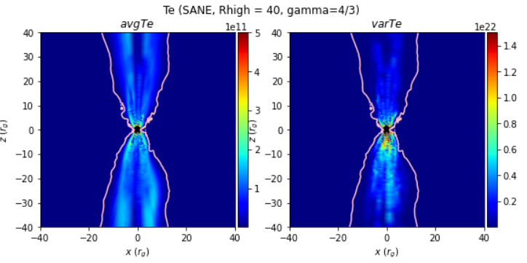
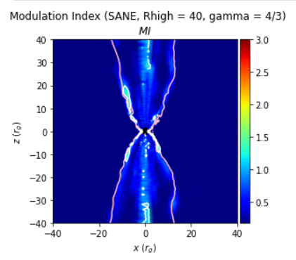
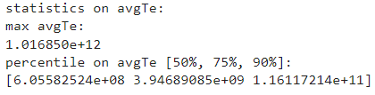
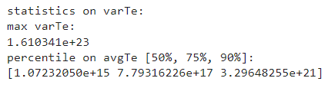
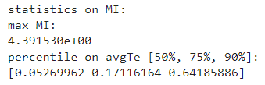
SANE, Rhigh=40

Slide 12
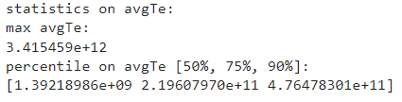
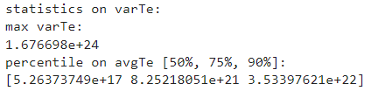
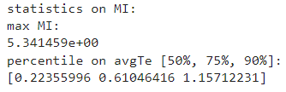
MAD, Rhigh=160

Slide 13
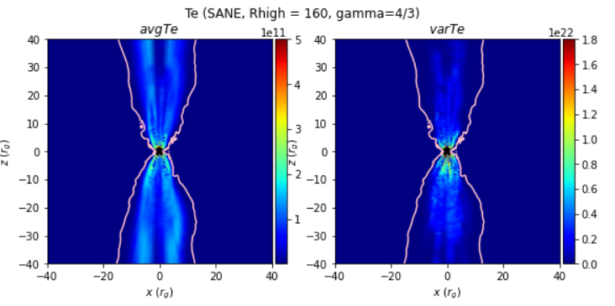
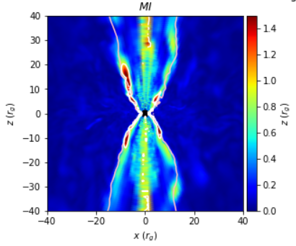
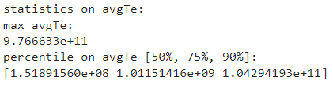
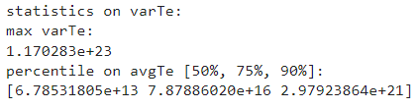
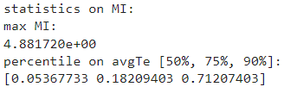
SANE, Rhigh=160

Slide 14
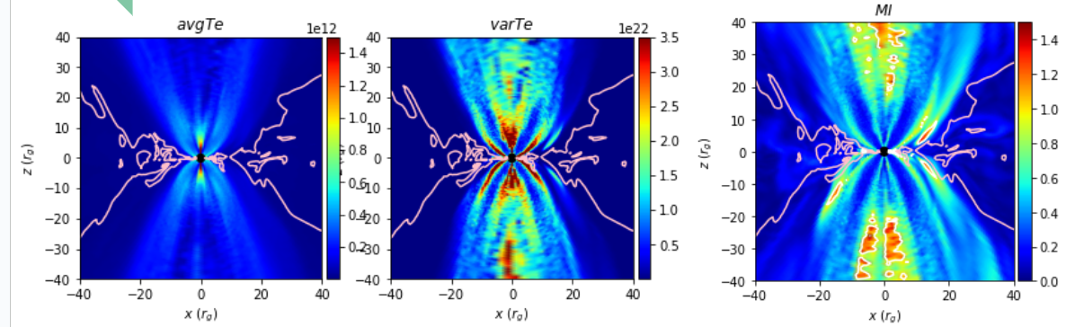
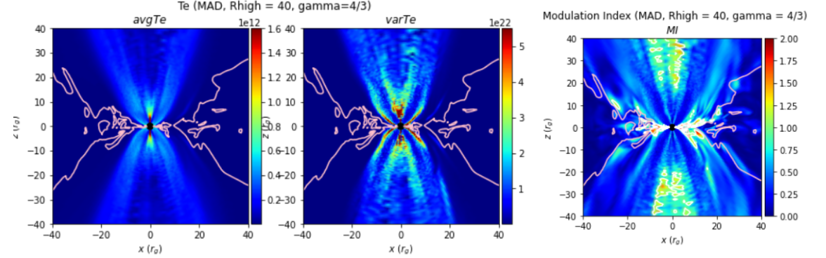
γ=4/3, MAD
Rhigh = 1
Rhigh = 160

Slide 15
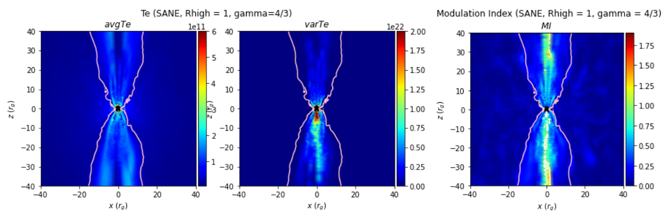
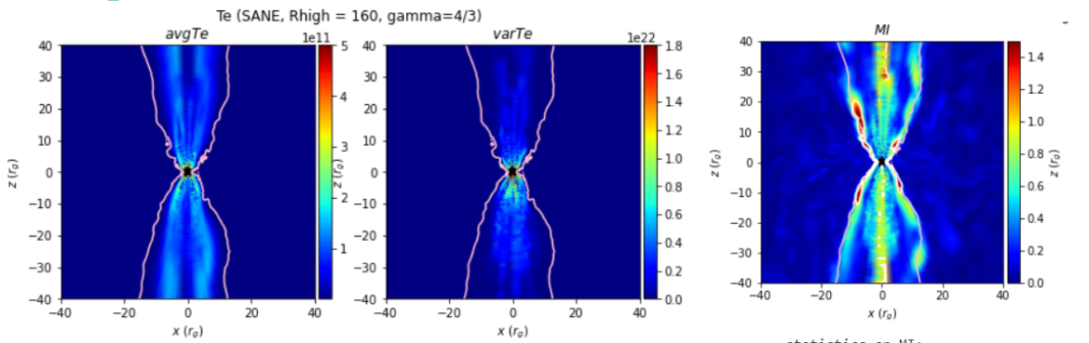
γ=4/3, SANE
Rhigh = 1
Rhigh = 160

Slide 16
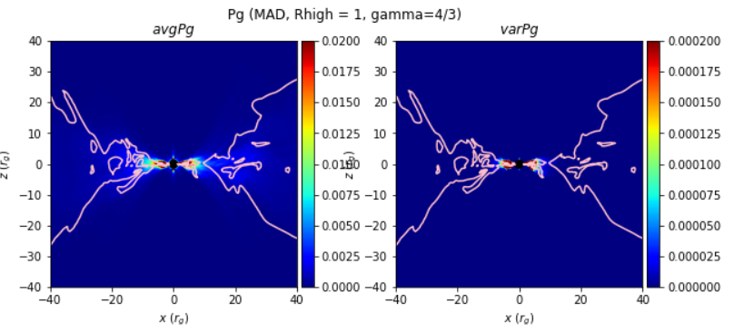
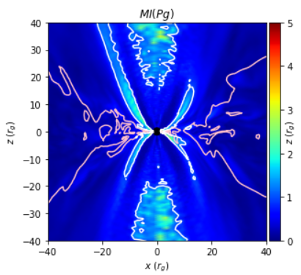
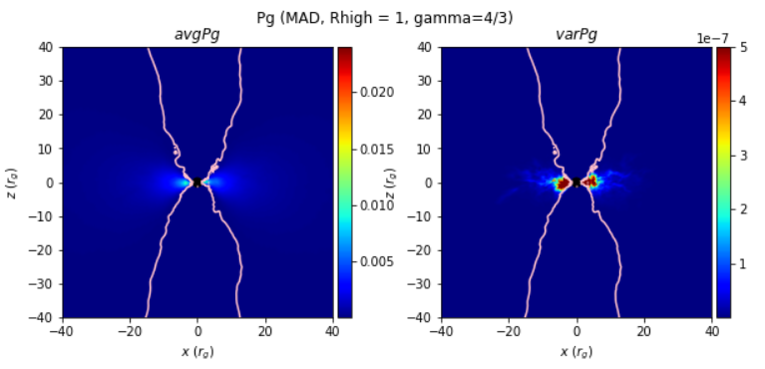
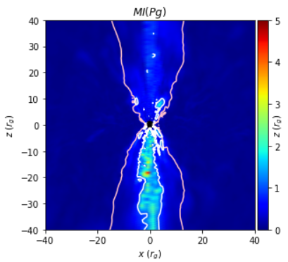
Any γ & Any Rhigh, Pg
MAD
SANE

Slide 17
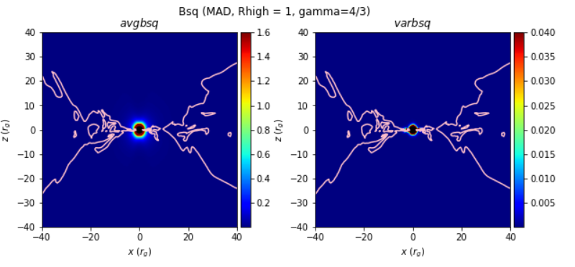
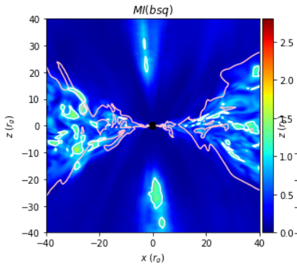
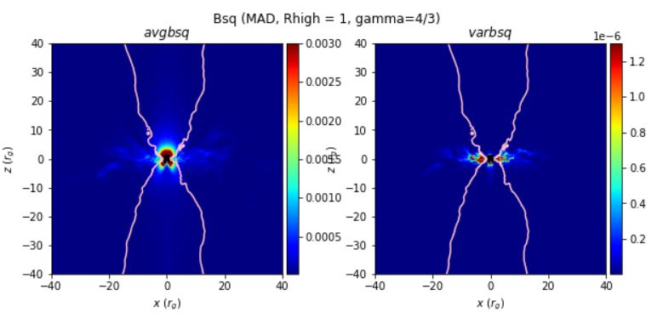
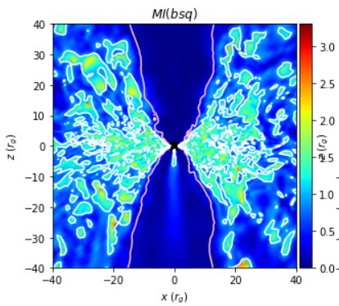
Any γ & Any Rhigh, B²
MAD
SANE

Slide 18
Observations
MAD has a much “wider” beta=1 surface …
Strong magnetic fields cumulate in the funnel and push out …
Not really the picture CK has in mind, but actually makes sense
Multiple layers of structures seen in MAD
Are they physical or numerical artifacts?
What are they? Are they related to field lines “attached” to the event horizon vs. to the disk? Is one “Alfven wave” propagation along field lines and the other precession?
Similar layers can be identified in SANE
But they are much weaker
var(Te_funnel) >> var(Te_disk)

Slide 19
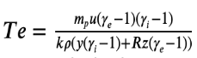
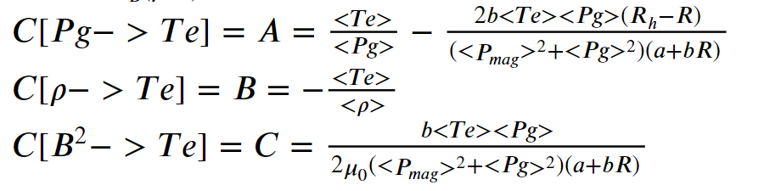
Derivations
Start from , use error propagation and derive an equation of var(Te) in terms of var(Pg), var(ρ), and var(B²), and their covariance terms
Equation should look something like this:
var(Te) = A²var(Pg) + B²var(ρ) + C²var(B²) + AB cov(Pg, ρ) + AC cov(Pg, B²) + BC cov(ρ, B²)
where A=C[Pg-> Te], B=C[ρ-> Te], C=C[B² -> Te]
Special thanks to Boris for helping me out on that!

Slide 21
TO-DOs
Optimize python code to reduce memory usage
Optimize python code to reduce I/O (and hence improve speed)
Implement 3hr module index routine

